Slide 1
A Demonstration of Text Input and Validation With Android Compose

Slide 2
DESCRIPTION
Jetpack Compose, Android's modern UI toolkit, makes creating and managing text input and validation intuitive and efficient. By leveraging its declarative approach, developers can design dynamic and responsive forms with minimal code. Here's an overview:
1. Simplified Input Handling
- Components like `TextField` and `OutlinedTextField` allow easy capture of user input.
- 2. Dynamic Validation:
- Validation logic, such as checking for empty fields or matching patterns (e.g., email format), can be directly integrated.
- 3. Styling and Customization:
- Customize text fields with themes, colors, shapes, and icons using `TextFieldDefaults`.
- Add helper text, placeholder hints, and input constraints for better UX.
Benefits:
- Real-Time Feedback: React to user input instantly with visual cues.
- Composable UI: Build reusable and modular input components.
- Modern Aesthetics: Create polished and consistent designs that adapt to Material Design guidelines.
This demonstration shows how Jetpack Compose empowers developers to create robust, validated input forms effortlessly, enhancing both user experience and developer productivity.

Slide 3
Main Activity.java:
package com.example.surveyapplication
import android.content.Context
import android.content.Intent
import android.os.Bundle
import androidx.activity.ComponentActivity
import androidx.activity.compose.setContent
import androidx.compose.foundation.Image
import androidx.compose.foundation.layout.*
import androidx.compose.material.*
import androidx.compose.runtime.*
import androidx.compose.ui.Alignment
import androidx.compose.ui.Modifier
import androidx.compose.ui.graphics.Color
import androidx.compose.ui.layout.ContentScale
import androidx.compose.ui.res.painterResource
import androidx.compose.ui.text.style.TextAlign
import androidx.compose.ui.tooling.preview.Preview
import androidx.compose.ui.unit.dp
import androidx.compose.ui.unit.sp

Slide 4
Import com.example.surveyapplication.ui.theme.SurveyApplicationTheme
class MainActivity : ComponentActivity() {
private lateinit var databaseHelper: SurveyDatabaseHelper
override fun onCreate(savedInstanceState: Bundle?) {
super.onCreate(savedInstanceState)
databaseHelper = SurveyDatabaseHelper(this)
setContent {
FormScreen(this, databaseHelper)
}
}
}
@Composable
fun FormScreen(context: Context, databaseHelper: SurveyDatabaseHelper) {
Image(
painterResource(id = R.drawable.background), contentDescription = "",
alpha =0.1F,
contentScale = ContentScale.FillHeight,
modifier = Modifier.padding(top = 40.dp)
)

Slide 5
// Define state for form fields
var name by remember { mutableStateOf("") }
var age by remember { mutableStateOf("") }
var mobileNumber by remember { mutableStateOf("") }
var genderOptions = listOf("Male", "Female", "Other")
var selectedGender by remember { mutableStateOf("") }
var error by remember { mutableStateOf("") }
var diabeticsOptions = listOf("Diabetic", "Not Diabetic")
var selectedDiabetics by remember { mutableStateOf("") }
Column(
modifier = Modifier.padding(24.dp),
horizontalAlignment = Alignment.Start,
verticalArrangement = Arrangement.SpaceEvenly
)

Slide 6
{
Text(
fontSize = 36.sp,
textAlign = TextAlign.Center,
text = "Survey on Diabetics",
color = Color(0xFF25b897)
)
Spacer(modifier = Modifier.height(24.dp))
Text(text = "Name :", fontSize = 20.sp)
TextField(
value = name,
onValueChange = { name = it },
) Spacer(modifier = Modifier.height(14.dp))
Text(text = "Age :", fontSize = 20.sp)
TextField(
value = age,
onValueChange = { age = it },
)

Slide 7
Spacer(modifier = Modifier.height(14.dp))
Text(text = "Mobile Number :", fontSize = 20.sp)
TextField(
value = mobileNumber,
onValueChange = { mobileNumber = it },
)
Spacer(modifier = Modifier.height(14.dp))
Text(text = "Gender :", fontSize = 20.sp)
RadioGroup(
options = genderOptions,
selectedOption = selectedGender,
onSelectedChange = { selectedGender = it }
)
Spacer(modifier = Modifier.height(14.dp))
Text(text = "Diabetics :", fontSize = 20.sp)

Slide 8
RadioGroup(
options = diabeticsOptions,
selectedOption = selectedDiabetics,
onSelectedChange = { selectedDiabetics = it }
)
// Display Submit button
Button(
onClick = { if (name.isNotEmpty() && age.isNotEmpty() && mobileNumber.isNotEmpty() &&
genderOptions.isNotEmpty() && diabeticsOptions.isNotEmpty()) {
val survey = Survey(
id = null,
name = name,
age = age,
mobileNumber = mobileNumber,
gender = selectedGender,
diabetics = selectedDiabetics
)
databaseHelper.insertSurvey(survey)
error = "Survey Completed"
}

Slide 9
else {
error = "Please fill all fields"
}
},
colors = ButtonDefaults.buttonColors(backgroundColor = Color(0xFF84adb8)),
modifier = Modifier.padding(start = 70.dp).size(height = 60.dp, width = 200.dp)
) {
Text(text = "Submit")
}
}
}
@Composable
fun RadioGroup(
options: List<String>,
selectedOption: String?,
onSelectedChange: (String) -> Unit
) {
Column {
options.forEach { option ->
Row(
Modifier
.fillMaxWidth()
.padding(horizontal = 5.dp)
)

Slide 10
{
RadioButton(
selected = option == selectedOption,
onClick = { onSelectedChange(option) }
)
Text(
text = option,
style = MaterialTheme.typography.body1.merge(),
modifier = Modifier.padding(top = 10.dp),
fontSize = 17.sp
)
}
}
}
}

Slide 11
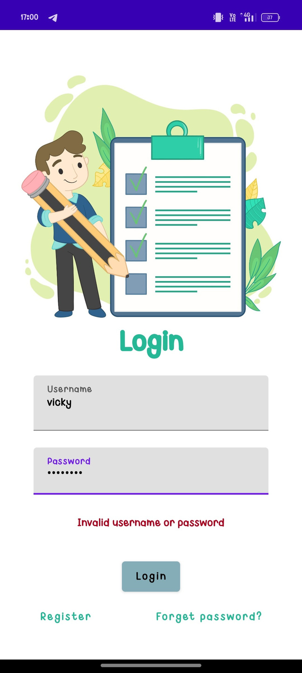
OUTPUT:

Slide 12
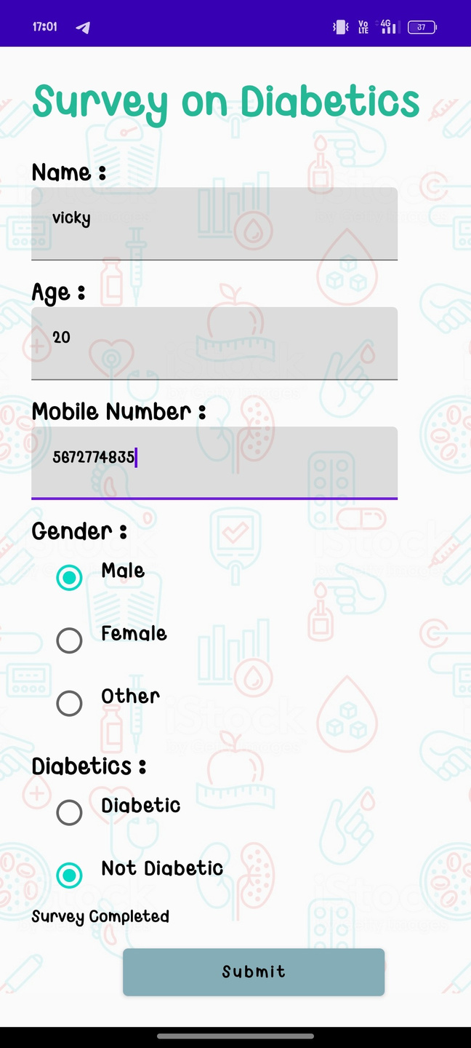

Slide 13
